Slide 1


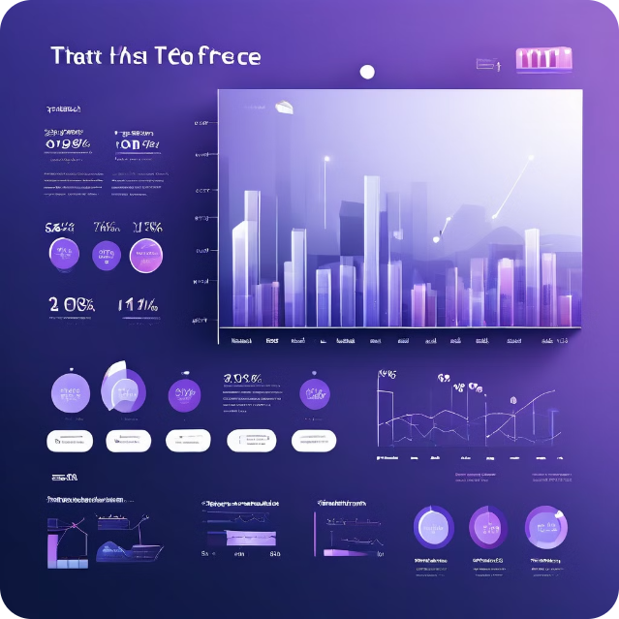
Q 1111q1s
Introduction
Hello! Greetings to all
I am here to present insights on the company’s sales performance for 2011. I appreciate the TATA Group for allowing me to analyze the store's performance data. Thanks to the CEO and CMO for guiding this analysis with their questions.

Slide 2
Thought Process
To ensure the accuracy and relevance of this analysis, I undertook several key steps. First, I meticulously cleaned the dataset, removing all negatives to eliminate inaccuracies. This was crucial for ensuring that the data accurately reflected our sales performance. I then applied specific filters to isolate the data relevant to each of the questions posed by our CEO and CMO. This included segmenting data by periods, geographic locations, and customer profiles. By doing so, I aimed to provide a clear, focused analysis that addresses the specific insights and trends of interest.
Additionally, I filtered the data to meet the specific requirements for each visualization.

Slide 3
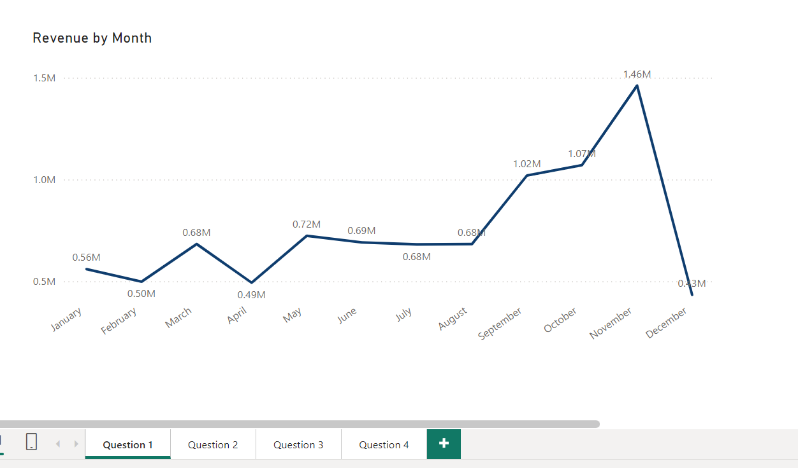
1
Question 1: Monthly Revenue Analysis for 2011 The analysis reveals that the first eight months of 2011 experienced consistent monthly revenue with an average of 685K. However, a notable seasonal trend emerges from August to December, highlighting a significant impact on sales during this period. This insight into seasonal fluctuations will aid in accurate forecasting and strategic planning for the upcoming year.

Slide 4
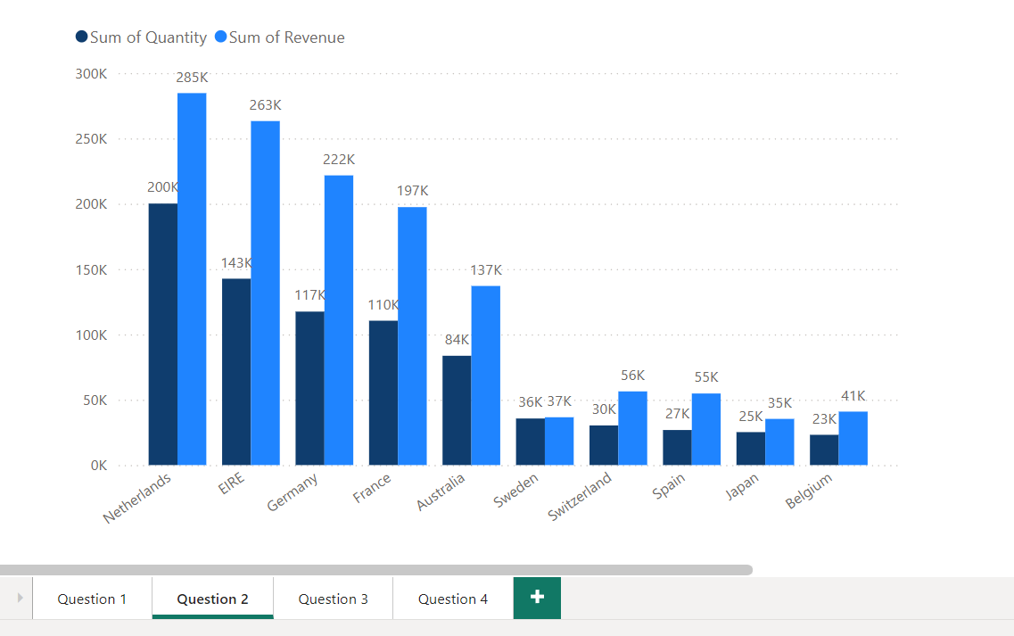
2
Question 2: Top 10 Countries by Revenue and Quantity Sold (Excluding UK) The visualization showcases the top 10 countries generating the highest revenue, excluding the United Kingdom. The data indicates minimal variation between revenue and quantity sold across these countries, suggesting strong purchasing power and consistent demand. This information is critical for strategic marketing and sales efforts.

Slide 5
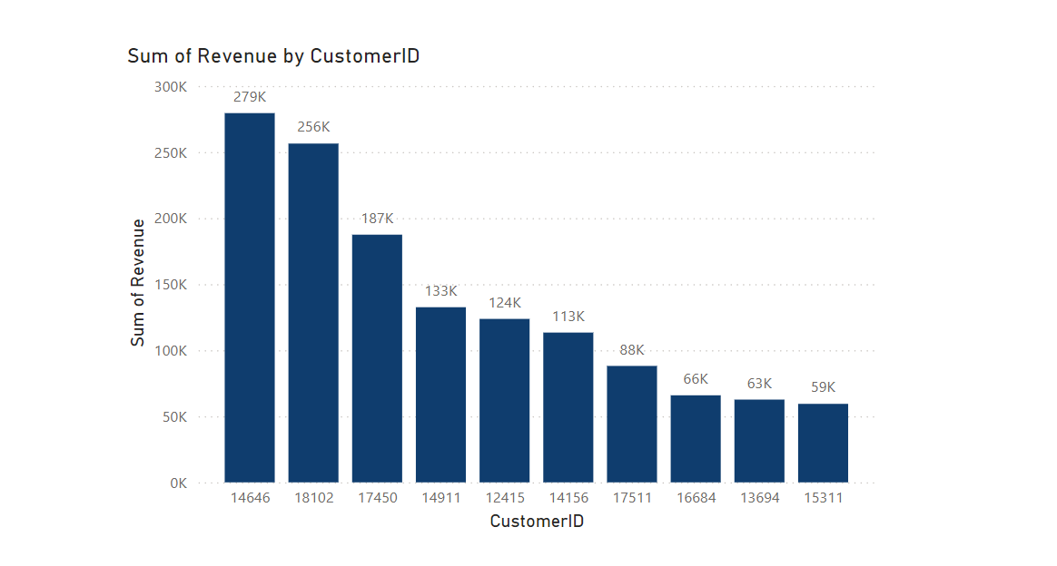
3
Question 3: Top 10 Customers by Revenue This visual ranks the top 10 customers by revenue, starting with the highest earners and descending to the lower revenue contributors. The average revenue difference between these customers is 15.8%. Focusing on these high-revenue customers can enhance customer loyalty and retention, ultimately driving increased sales and revenue.

Slide 6
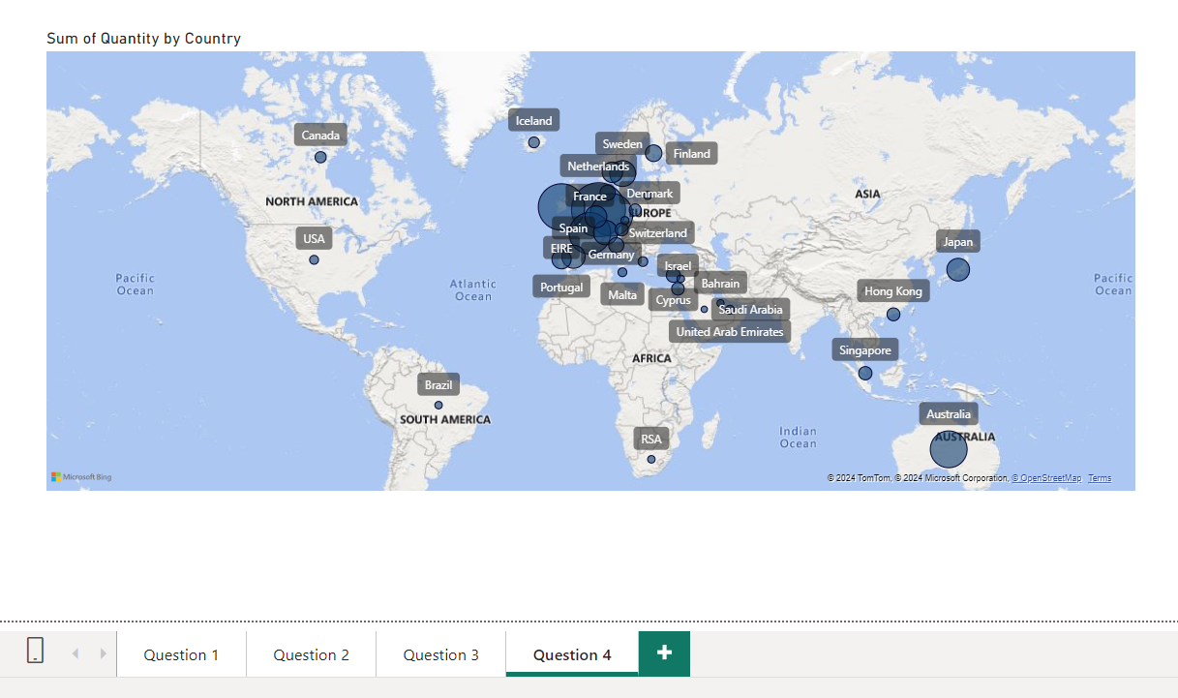
4
Question 4: Global Demand Analysis (Excluding UK) The map highlights the global demand for products, comparing regions with the highest revenue to those with lower sales. It is evident that there are no significant markets in Africa, Asia, and Russia, with most sales concentrated in Europe. This insight points to potential expansion opportunities in underserved regions, guiding strategic initiatives to maximize global market presence.

Slide 7
Recommendations
•Develop targeted strategies to stock and advertise seasonal products, maximizing sales during high-demand periods. This could include promotional campaigns and optimized inventory management during peak seasons
•Build and nurture strong relationships with our top customers who place large orders. Personalized marketing, loyalty programs, and dedicated customer support can increase retention and ensure long-term satisfaction
•Focus on expanding our presence in the European market, which shows significant growth potential. Tailored marketing strategies, localized product offerings, and strategic partnerships can help us capture a larger market.

